Slide 1
REGRESSION CHALLENGE
STATISTICAL LEARNING AND DATA MINING
54875

Slide 2
PRELIMINAY ANALYSIS
REQUIRED LIBRARIES:-library(alr4),library(caret),library(utils)
IMPORTING DATA:- USED SETWD AND GETWD TO DIRECT THE PATH.
IMPORT DATASET USING READ.CSV FUNCTION.
TRAIN DATASET- GIVEN OBSERVATIONS USED TO ANALYSE AND FIT THE REGRESSION USING REGRESSION ASSUMPTIONS.
TEST DATASET- GIVEN OBSERVATIONS USED FOR THE PREDICTION USING THE FITTED TRAINED DATASET.

Slide 3
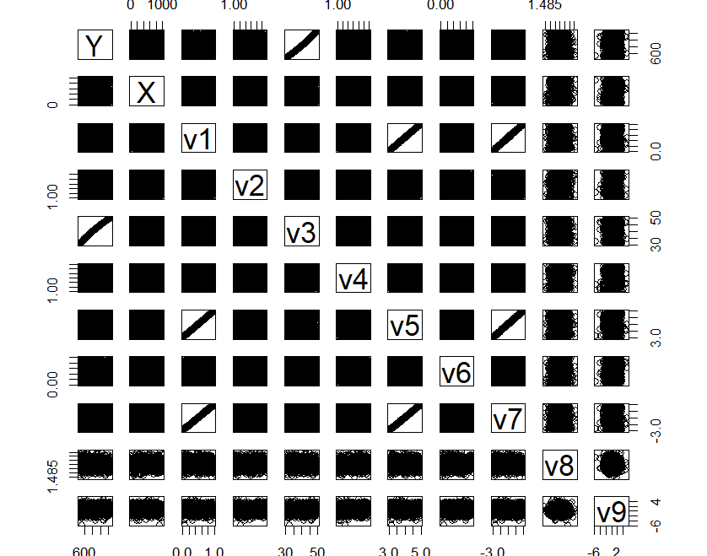
FITTING PROCESS
USED PAIRS TO VISUALIZE THE DATA.
WE HAVE COLINEARITY BETWEEN V1,V5,V7. WE REMOVED THOSE VARIABLES.
TEST OF CURVATURE: RESIDUAL PLOTS TO CHECK THE CURVATURE IN OUR MODEL.

Slide 4
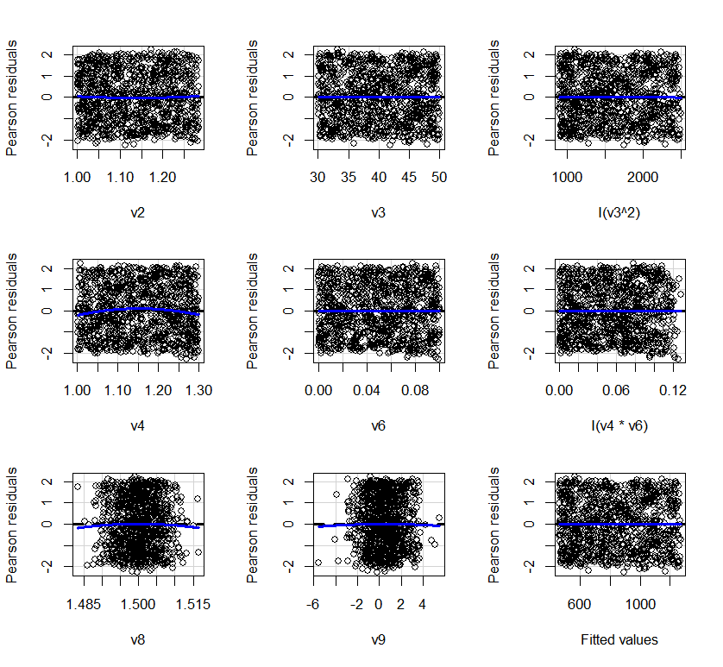
FITTING PROCESS
TRANSFORMATION OF V3 INTO QUADRATIC AND INTERACTING V4&V6.
TRANSFORMED MODEL DOESN’T PROVIDE CURVATURE IN RESIDUAL PLOTS.
ALSO BY ANALYSING THE GRAPHS THE VARIANCE IS CONSTANT. (not significant)
Non-constant Variance Score Test
Variance formula: ~ fitted.values
Chisquare = 0.08089681, Df = 1, p = 0.77609

Slide 5
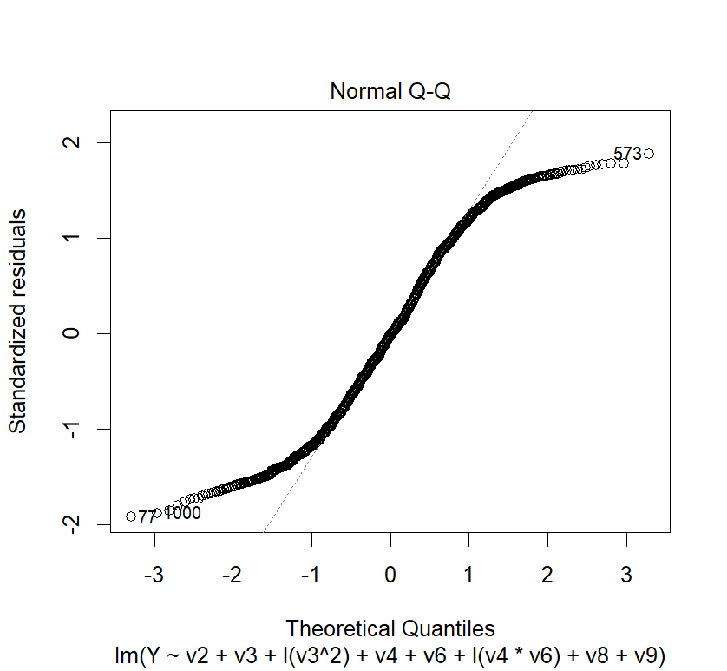
FITTING PROCESS
CHECKING FOR OUTLIERS TO OVERCOME THE INFLULENTALITY.
CHECKING NORMALITY TO MEET THE ASSUMPTIONS, OUR DATA IS ALMOST NORMALLY DISTRIBUTED. ‘n’ IS LARGE.
FINALLY MET ALL THREE ASSUMPTIONS. READY FOR PREDICTION AND INFERENCE.

Slide 6
COMPARING THE LM & KNN PREDICTIONS
GENERATED PREDICTED VALUES FOR BOTH LM MODEL AND KNN MODEL USING PREDICT FUNCTION FOR TEST DATA.
THE RESULTS OF THE LM MODEL ARE LARGER IN VALUE COMPARED TO THE KNN RESULTS.
KNN VALUES ARE THE MOST OPTIMAL RESULTS COMPARED TO LM BECAUSE AS WE KNOW NON-PARAMETRIC RESULTS PROVIDE THE BEST VALUES WITH LESS MSE AND ARE GOOD FOR PREDICTION COMPARED TO OLS.

